Slide 1
Novel Approach to Lithium Extraction on a String
Avi Patel

Slide 2
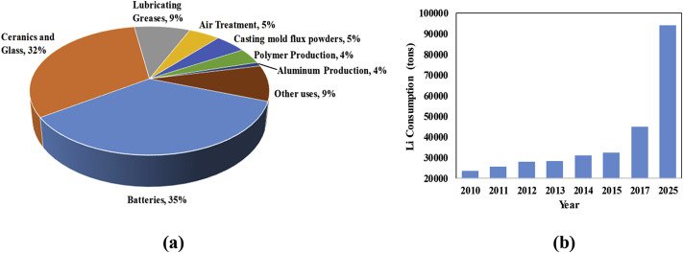
Why Lithium?
Electric vehicles, consumer electronics and energy storage systems
Limited Li supply cannot keep up with demand
Xianhui Li, Yinghui Mo, Weihua Qing, Senlin Shao, Chuyang Y. Tang, Jianxin Li,
Membrane-based technologies for lithium recovery from water lithium resources: A review,
Journal of Membrane Science, Volume 591, 2019, 117317, ISSN 0376-7388,
https://doi.org/10.1016/j.memsci.2019.117317.
Notes:
Lithium is used for EVs, consumer electronics and energy storage devices (LiPo batteries)
Due to both a limited supply and increasing demand for the metal, lithium is becoming an increasingly important resource
Increasing gap between supply and demand for lithium

Slide 3
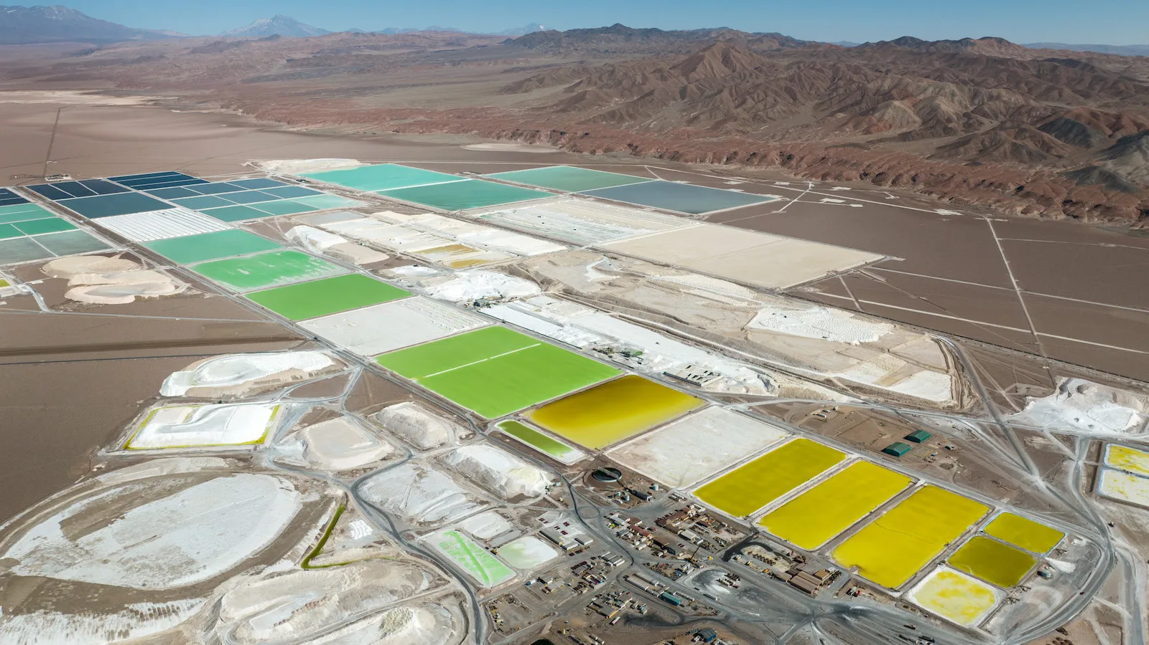
Motivation
Almost all lithium mining occurs in Latin America, Australia and China
Salar de Atacama Lithium Production Site
Chile's national lithium strategy raises questions about the environmental and social costs of EVs | Grist
Notes:
Motivation:
Almost all of Li mining occurs in Latin America, Australia and China with over half of Li production+extraction originating from continental brines.
Image of one of the largest sites of Li extraction called Salar de Atacama in Chile.
2019 this site produced ~20 of the global Li supply
Expansive site containing many evaporation pools used to separate Li
Processes take a long time (15-18 months)
Harmful to the local groundwater supply and surrounding ecosystems
Cannot be performed using brine sources with low lithium concentrations

Slide 4
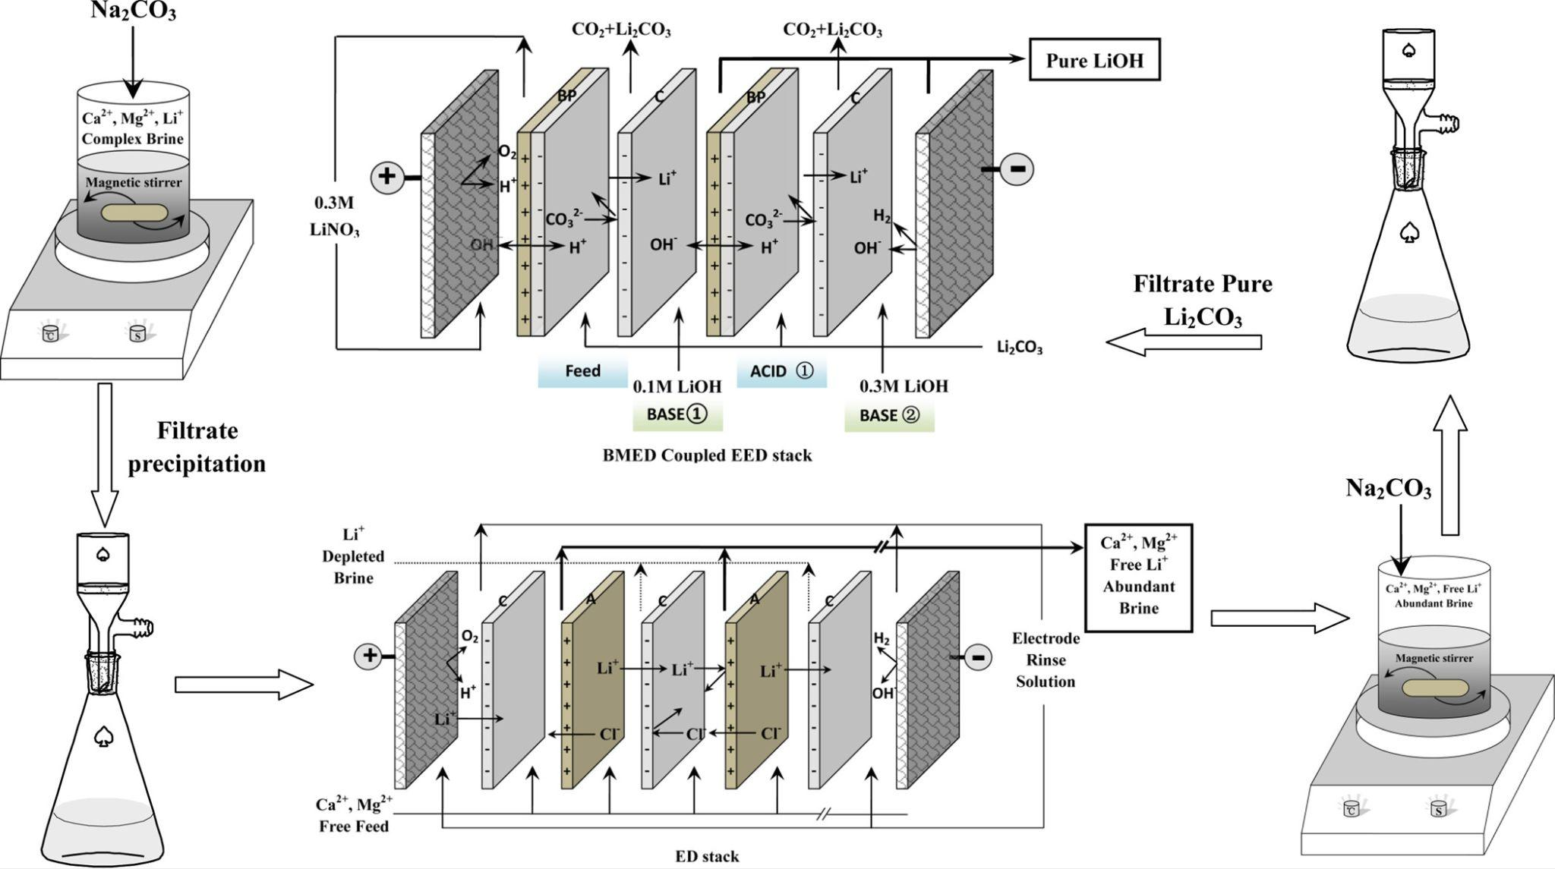
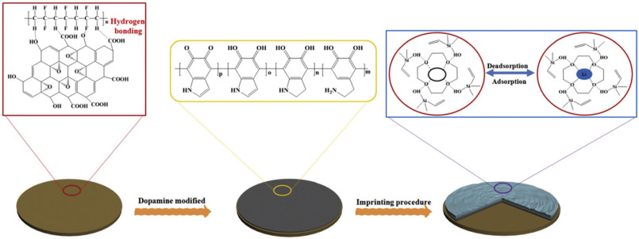
Membrane-based Li Extraction Technologies
Costly, high energy and use more chemicals
Chenxiao Jiang, Yaoming Wang, Qiuyue Wang, Hongyan Feng, and Tongwen Xu Industrial & Engineering Chemistry Research 2014 53 (14), 6103-6112 DOI: 10.1021/ie404334s
J.Y. Cui, Y.F. Zhang, Y. Wang, J.Y. Ding, P.H. Yu, Y.S. Yan, C.X. Li, Z.P. Zhou, New J. Chem., 42 (2018), pp. 118-128
DOI: 10.1039/C7NJ03152A
Notes:
Membrane-based Li extraction technologies attempt to address these concerns but while these approaches show promise in being able to tap into lower concentration Li brines such as seawater
Current development is hindered due to being energy intensive, costly/inefficient and use many chemicals
Left panel: An example of a technique called electrodialysis → use an E-field to drive ion exchange using a selective membrane is both inefficient and energy intensive
Right panel: An example of solvent extraction → polymer membrane is engineered to have high Li selectivity through a multistage process involving numerous chemical reactions
Energy intensive and uses many organic solvents when scaled up

Slide 5
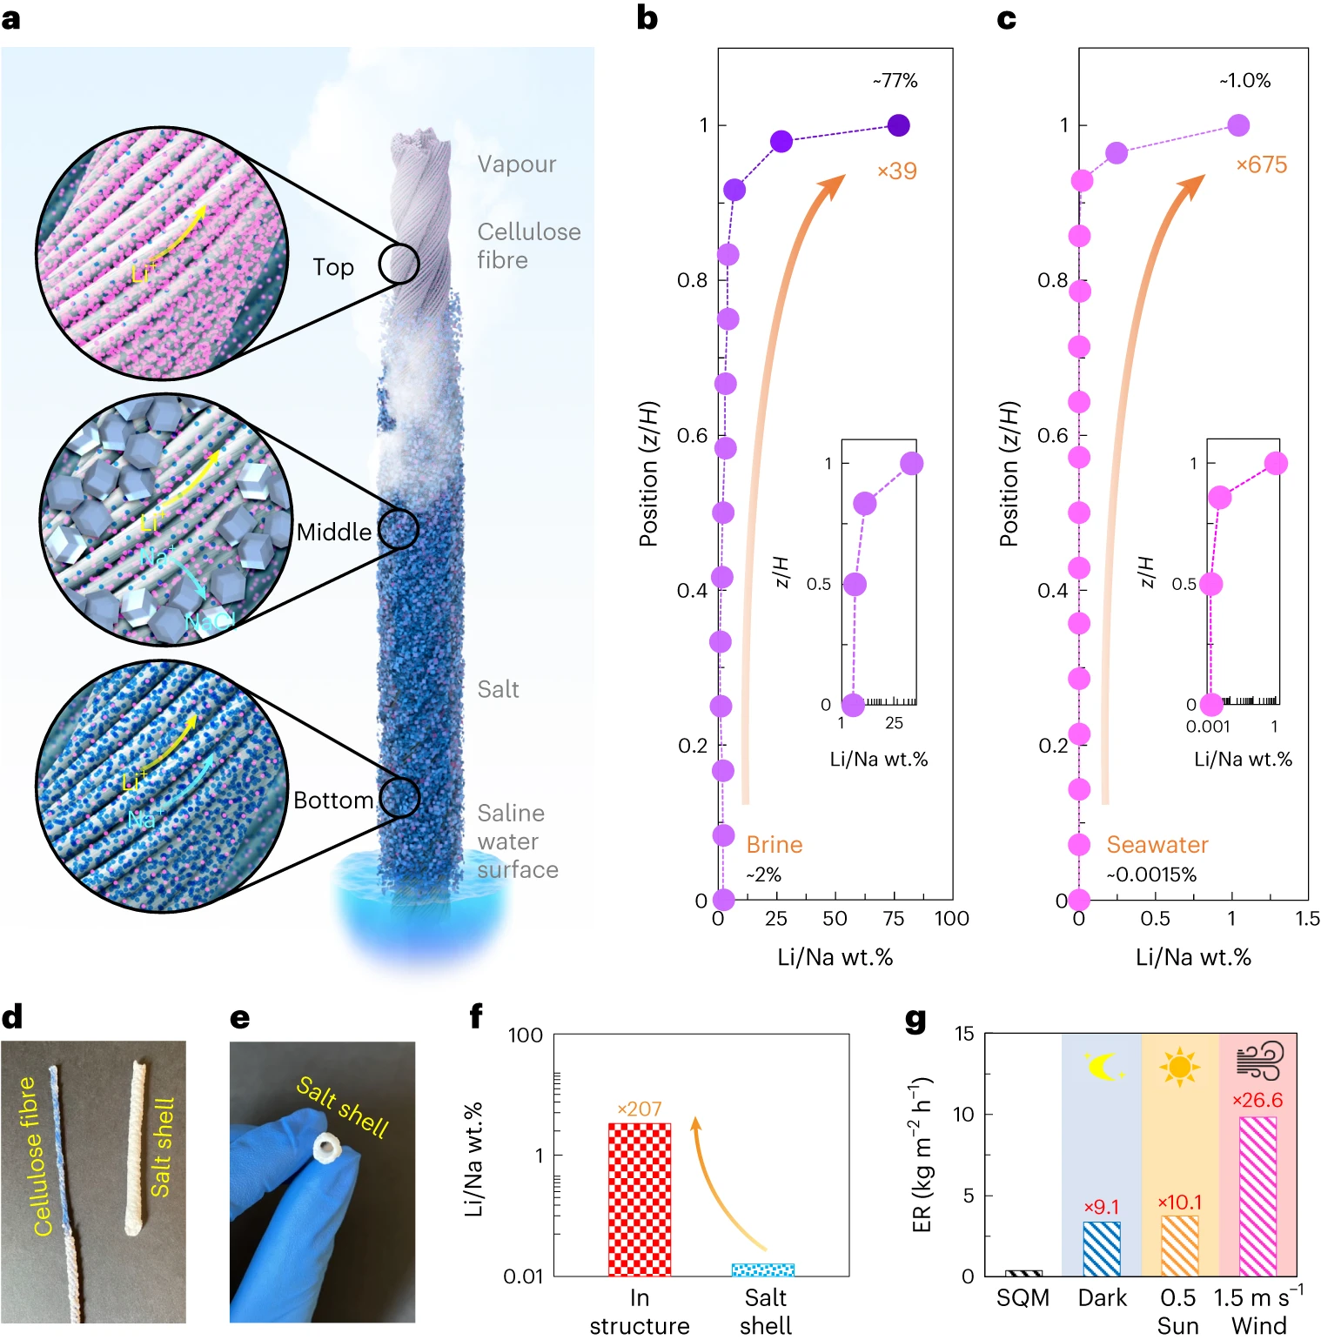
How the Li extraction works?
Chen et al. 2023 developed an extraction process for Li using evaporation and capillary action
Crystallization process of Na and Li on porous strings
Chen, X., Yang, M., Zheng, S. et al. Spatially separated crystallization for selective lithium extraction from saline water. Nat Water 1, 808–817 (2023). https://doi.org/10.1038/s44221-023-00131-3
Notes:
Porous fibers twisted into strings are dipped in a saline solution
Water from the saltwater brine travels up the porous strings via capillary action where the water quickly evaporates leaving behind the Li and Na ions that crystalize onto the rope.
Similar to how trees suck up water from the ground
Salts with higher concentrations and lower solubilities such as NaCl evaporate more quickly and crystallize lower on the string while salts with lower concentrations and higher solubilities such as LiCl crystallize higher up on the string.
Provides spatial separation for recovery (Panel A, B, C)
(Panel d,e) spatial separation was observed along radial direction → not important
(Panel g) Measured ER of 100 crystallizers array and found they were ~27 larger than the evaporation ponds from Atacama de chile (SQM)

Slide 6
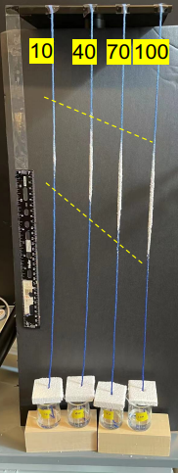
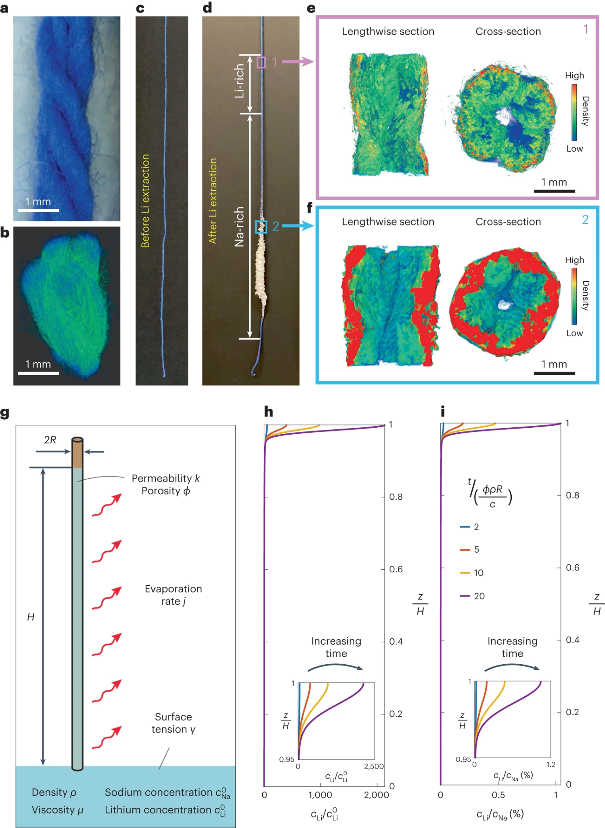
Experimental Results
Crystallization from brine before and after 60 hr
NaCl crystallization at various heights along porous string
Chen, X., Yang, M., Zheng, S. et al. Spatially separated crystallization for selective lithium extraction from saline water. Nat Water 1, 808–817 (2023). https://doi.org/10.1038/s44221-023-00131-3
Notes:
NaCl crystals formed roughly ⅓ of the way up the string while salt layer became gradually thinner upwards.
Density profiles taken using x-ray imaging show this
Right panel: height of NaCl crystallization decreases along porous string as concentration of saline solution increases
They tested various concentrations of NaCl solution from 10 to 100M and observed that the height of crystallization decreases with increasing concentration

Slide 7
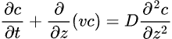
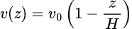
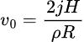
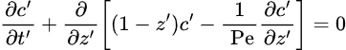
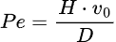
Model
1D Tracer Transport for Li and Na ions through the porous string
Scaling Analysis:
Natural Outflow
H
Sodium concentration: c⁰_{Na}
Lithium concentration: c⁰_{Li}
Notes:
used initial concentrations based on the brine composition at Salar de Atacama

Slide 8
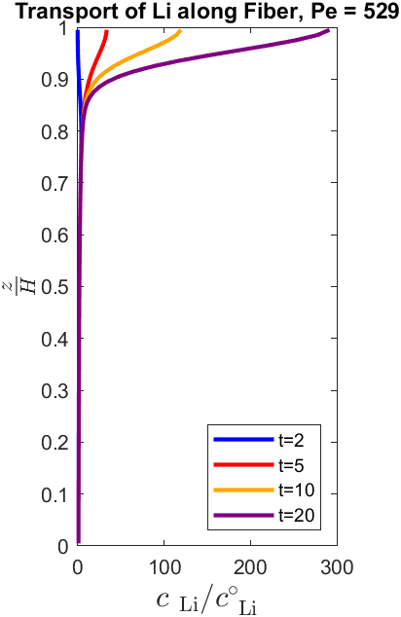
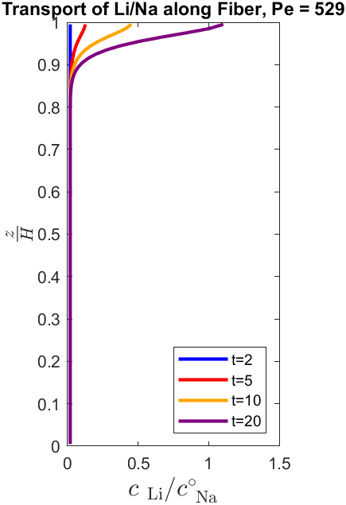
Model Results
Our Results
Results from Chen et al. 2023
Chen, X., Yang, M., Zheng, S. et al. Spatially separated crystallization for selective lithium extraction from saline water. Nat Water 1, 808–817 (2023). https://doi.org/10.1038/s44221-023-00131-3
Notes:
Our results and Chen and their colleagues are similar
slight differences in shape and relative concentrations between Li and Na
Concentration of Li is highest at the top of the string and increases over time

Slide 9
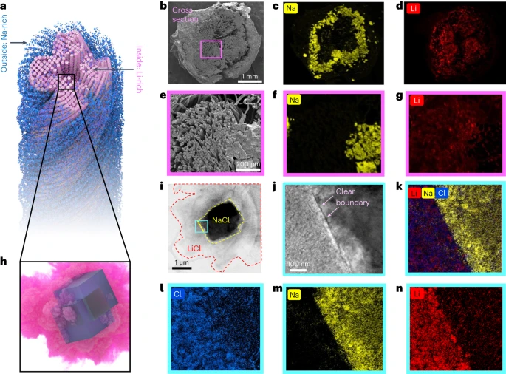
Limitations of Model
Does not factor in crystallization of ionic species
In radial direction, Na crystallizes on the outside while Li concentrates towards the center
Spatial mapping of Na and Li crystallization across porous strings
Chen, X., Yang, M., Zheng, S. et al. Spatially separated crystallization for selective lithium extraction from saline water. Nat Water 1, 808–817 (2023). https://doi.org/10.1038/s44221-023-00131-3
Notes:
One aspect the model is lacking is the precipitation of Na and Li from the porous strings.
Also evaporation is occurring throughout the length of the string not only at the top.
Right shows the spatial variation of Li and Na across the rope
Addition of a radial coordinate for the model to examine the concentration of these species across the thickness of the string

Slide 10
Conclusion
Li separation from saltwater brine using porous fibers is a powerful technique using evaporation and capillary action
More compact, affordable and efficient solution
Notes:
Material to produce fibers is cheap and tech does not require chemicals to enhance separation
Overall, it is a more compact, affordable and efficient solution

